Slide 1
Boolean Algebra

Slide 2
LOGIC GATES
Formal logic: In formal logic, a statement (proposition) is a declarative sentence that is either
true(1) or false (0)
We are using formal logic to communicate with computers
Boolean variable: Takes only two values:
– either true (1) or false (0)

Slide 3
Boolean function & logic diagram
Boolean function:
Mapping from Boolean variables to a Boolean value▪
Truth table:
It enumerates all possible combinations of arguments and the corresponding function values▪
Logic diagram:
Composed of graphic symbols for logic gates▪ A simple circuit sketch
that represents inputs and outputs of Boolean functions

Slide 4
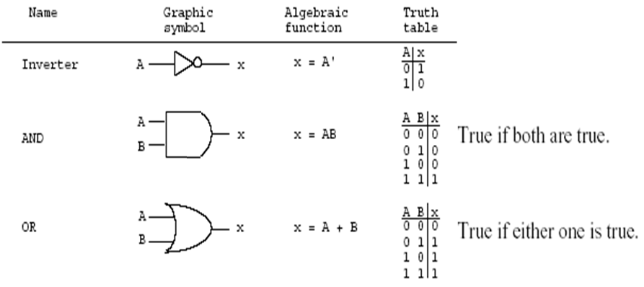
Gates - hardware to implement Boolean operators
The most basic gates are

Slide 5
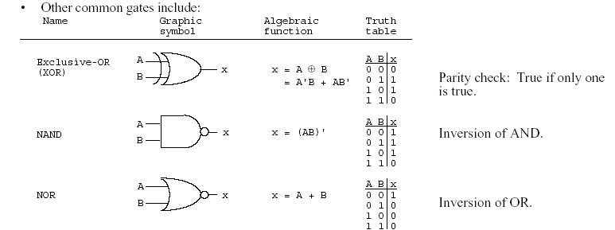
Boolean function and truth table

Slide 6
BASIC IDENTITIES OF BOOLEAN ALGEBRA
Postulate 1 (Definition):
A Boolean algebra is a closed algebraic system containing a set K of two or more elements and the two operators · and + which refer to logical AND and logical OR
< K, +, ·, ’, 0, 1>

Slide 7
Basic Identities of Boolean Algebra
1▪ Existence of 1 and 0 element:
x + 0 = x x · 0 = 0
x + 1 = 1 x · 1 = 1
2▪ Existence of complement
x + x = x x · x = x
x + x’ = x x · x’ = 0
3▪ Commutativity
x + y = y + x xy = yx

Slide 8
Basic Identities of Boolean Algebra
Associativity
x + ( y + z ) = ( x + y ) + z
x (yz) = (xy) z
Distributivity
x ( y + z ) = xy + xz
x + yz = ( x + y )( x + z)
Involution
(x’)’ = x

Slide 9
Basic Identities of Boolean Algebra de Morgan’s Theorem
(x + y)’ = x’ y’
(xy)’ = x’ + y’
x + y = x y
xy = x + y

Slide 10
Function Minimization using Boolean Algebra
Examples:
a + ab = a(1+b)=a
a(a + b) = a▪a +ab=a+ab=a(1+b)=a
a + a'b = (a + a')(a + b)=1(a + b) =a+b
a(a' + b) = a▪ a' +ab=0+ab=ab

Slide 11
The other type of question
Show that:
(1) ab + ab' = a
(2) (a + b)(a + b') = a
ab + ab' = a(b+b') = a▪1=a
(2) (a + b)(a + b') = a▪a +a▪b' +a▪b+b▪b'
= a + a▪b' +a▪b + 0
= a + a▪(b' +b) + 0
= a + a▪1 + 0
= a + a = a

Slide 12
More Examples
Show that:
(a) ab + ab'c = ab + ac
(b) (a + b)(a + b' + c) = a + bc
(a) ab + ab'c = a(b + b'c)
= a((b+b')▪(b+c))=a(b+c)=ab+ac
(b) (a + b)(a + b' + c)
= (a▪a + a▪b' + a▪c + ab +b▪b' +bc)
= …

Slide 13
DeMorgan's Theorem
(a) (a + b)' = a'b'
(b) (ab)' = a' + b'
Generalized DeMorgan's Theorem
(a) (a + b + … z)' = a'b' … z'
(b) (a▪b … z)' = a' + b' + … z‘

Slide 14
DeMorgan's Theorem
F = ab + c’d’
F’ = ??
F = ab + c’d’ + b’d
F’ = ??

Slide 15
DeMorgan's Theorem
Show that: (a + b▪c)' = a'▪b' + a'▪c'

Slide 16
More Examples
(a(b + c) + a'b)'=b'(a' + c')
ab + a'c + bc = ab + a'c
(a + b)(a' + c)(b + c) = (a + b)(a' + c)

Slide 17
More DeMorgan's example
Show that: (a(b + z(x + a')))' =a' + b' (z' + x')
(a(b + z(x + a')))' = a' + (b + z(x + a'))'
= a' + b' (z(x + a'))'
= a' + b' (z' + (x + a')')
= a' + b' (z' + x'(a')')
= a' + b' (z' + x'a)
=a‘+b' z' + b'x'a
=(a‘+ b'x'a) + b' z'
=(a‘+ b'x‘)(a +a‘) + b' z'
= a‘+ b'x‘+ b' z‘
= a' + b' (z' + x')

